Slide 1

Hypervisors vs. Lightweight Virtualization
A Performance Comparison
Roberto Morabito
Ericsson Research
Tempe, Arizona – 09 March, 2015

Slide 2
Outline
Introduction
Hypervisors, Containers, other solutions
Methodology and Experimental Setup
Benchmark Results
Conclusions
Future Work

Slide 3
Introduction
Motivation:
  Usage of Virtualization in others context such as Cloud Environments, Internet of Things, Network Function Virtualization.
  Hypervisors reduced overhead
  Lightweight Virtualization claim to offer superior performance
    Container-based Solution became very popular
    Other emerging solutions are gaining prominence
Goal:
  Quantify level of overhead
  Understand strengths, weaknesses, and anomalies of different platforms

Slide 4
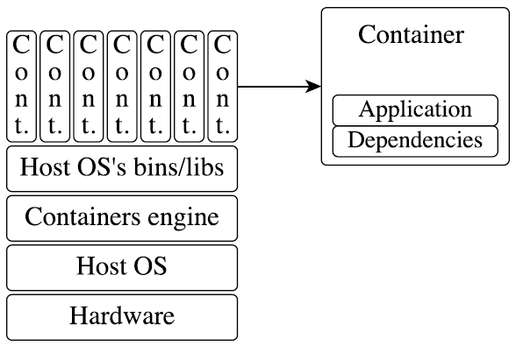



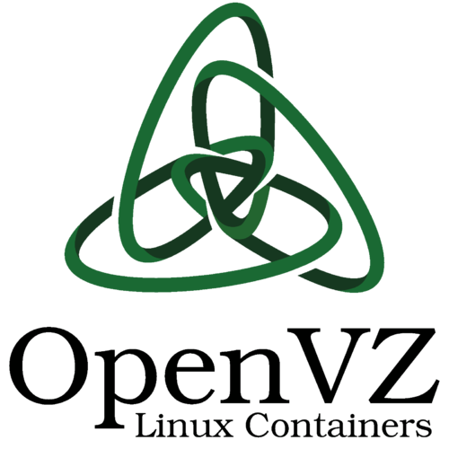

Introduction
Container-based Virtualization Architecture
Lightweight alternative to hypervisor-based virtualization
Containers implement isolation of processes at the OS level
Run on top of the same shared OS kernel of the underlying host machine
Higher density of virtualized instances
Containers do not isolate resources as well as hypervisors
LXC

Slide 5
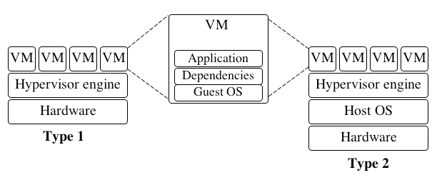


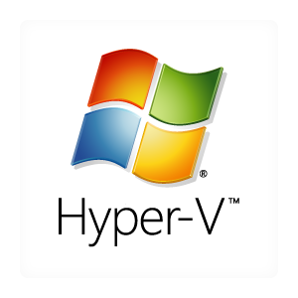
Introduction
Hypervisor-based Virtualization Architecture
Hypervisors operate at the hardware level → supporting standalone VM that are independent and isolated from the host system
  Trade-off: a full OS is installed to the VM → larger image
  Emulation of virtual hardware devices incurs more overhead

Slide 6

Introduction
Alternative Virtualization Architecture
OSv: dedicated OS designed exclusively for the Cloud Computing
  OSv is intended to be run on top of a hypervisor (KVM, Xen, Virtual Box, etc.)
  It achieves the isolation benefits of hypervisor-based systems, but avoids the overhead of the Guest OS
  OSv applications can be built and executed via the Capstan tool that is conceptually similar to Docker
  Several issues especially concerning software portability/compatibility
Application
Minimal lib. OS
(e.g. OS^{V})
Hypervisor
(e.g. KVM)
Host OS
(Linux)
Hardware
OSv “Stack”

Slide 7
Methodology
Experimental Setup
Host machines
  Computer Model: Dell Precision T5500
  Processor: CPU Intel Xeon X5560@ 2.80GHz,
  4 cores (8 threads)
  RAM Memory: 12 GB (3x4GB) 1333 MHz DDR3
  Disk: OCZ-VERTEX 128GB SSD
  Network Interface:10-Gigabit NIC (Dual Port)
  OS: Ubuntu 14.04 LTS
Hypervisor, containers, OSv
  KVM (QEMU emulator version 2.0.0)
  LXC 1.0.6
  Docker 1.3.2
  OSv 0.15
KVM is managed using the standard Linux libvirt API and toolchain (virsh)
OSv is running over KVM
LXC and Docker are running directly over the host OS
Linux Guest OS on KVM is Ubuntu 14.04 (64bit)
Individual measurements are repeated at least 15 times
General benchmarking
  Real Systems are usually different from our basic environment
  Real Application and their workloads are different than generic benchmarking tools

Slide 8
Benchmark Results
CPU
Disk I/O
Memory
Network I/O
LXC

Slide 9

CPU Performance
Benchmark tools:
  Y-cruncher
  NBENCH
  Geekbench
  noploop
  Linpack
LXC
LXC

Slide 10
CPU Performance
Y-cruncher
  Multi-threaded benchmark tool
  Pi calculation
  Better than other similar alternatives (super-Pi etc.)
Pi Computation

Slide 11
CPU Performance
Y-cruncher
  Multi-threaded benchmark tool
  Pi calculation
  Better than other similar alternatives (super-Pi etc.)
Multi-core Efficiency

Slide 12
CPU Performance
NBENCH
  Single-threaded benchmark tool
  10 algorithms
  Three different Index are provided
NBENCH Index

Slide 13
CPU Performance
noploop
  Very simple tool
  Very easy OSv porting
noploop output

Slide 14
CPU Performance
Linpack
  Two variants
  System performance are tested using a simple linear algebra problem
  Result is given in MegaFLOPS

Slide 15
CPU Performance
Linpack result with varying matrix dimension
  Three different “regions” can be detected
  OSv presents some performance degradation (for low N values)

Slide 16
Disk I/O Performance
Benchmark tools:
  Bonnie++
  IOzone
  Sysbench
  dd
LXC

Slide 17
Disk I/O Performance
≈11%
Bonnie++
Not supported by OSv
Test file size: 25 Gib
Results for Mixed test:
  KVM disk throughput achieves the worst performance
  LXC is still performing slightly better than Docker (4% faster)

Slide 18
Disk I/O Performance
≈35%
Bonnie++
Not supported by OSv
Test file size: 25 Gib
Results for Random Seek measurement:
  The order of the platforms is the same
  LXC is performing now quite much better than Docker (approximately 35%)
  KVM has a very poor performance

Slide 19
Disk I/O Performance
Results for Disk I/O measurements:
  Mismatch between the results of Bonnie++ and other tools (Sysbench and IOzone)
  Other works^{[X]} confirm unusual results
  No material that compares/evaluates Disk I/O benchmarking tools reliability
Alternative Disk I/O evaluation using Unix-like command dd:
  It is used for several things: recovering data, backing up function, data conversion etc.
  We use dd to read and write from special device files (/dev/zero/)
  Test file size of 50 Gib – Block size (512 and 1024 bytes)
^{[X]} Estrada, Zachary J., et al. "A Performance Evaluation of Sequence Alignment Software in Virtualized Environments." Cluster, Cloud and Grid Computing (CCGrid), 2014 14th IEEE/ACM International Symposium on. IEEE, 2014.

Slide 20
Disk I/O Performance
Platform | Disk I/O speed
Native | 122 MB/s
LXC | 92 MB/s
Docker | 113 MB/s
KVM | 49.8 MB/s
dd (average over 20 run) results show:
  Bonnie++ results are approximately confirmed
  Native, KVM, and LXC obtained always the same output (without any valuable deviation)
  Docker was performing (for few run) better than Native distribution (135 MB/s)

Slide 21
Memory Performance
Benchmark tools:
  STREAM
LXC

Slide 22
Memory Performance
STREAM Test
  It measures memory performance using very simple vector kernel operations.
  Strong dependency to the CPU cache size → Big Stream Array
Operation | Kernel
Copy | x[i] = y[i]
Scale | x[i] = q * y[i]
Add | x[i] = y[i] + z[i]
Triad | x[i] = y[i] + q * z[i]

Slide 23
Memory Performance
Results for STREAM memory test:
  KVM, Docker, and LXC all reach performance similar to the native execution
  OSv introduces a considerable gap compared with the other platforms

Slide 24

Network Performance
Network performance evaluation – Experimental setup:
  Two identical hosts directly connected with 10 Gigabit Ethernet Link
  Netperf benchmark tool is used
  One host is running netperf client and the other netperf server
  netperf server is running on the tested platform
  60 seconds each test
  TCP_STREAM, TCP_RR, UDP_STREAM, UDP_RR
  IPv4 addresses
Client
Server

Slide 25
Network Performance
Benchmark tools:
  Netperf
  Iperf
LXC

Slide 26
Network Performance
TCP_STREAM Test
  Default test in netperf
  Simple TCP data transmission between client and server
≈28%
≈26%
Results for TCP_STREAM test:
  Docker and LXC achieve almost equal performance compared to Native
  KVM is 28.41% slower than the non-virtualized environment
  OSv is faster than KVM, but the gap compared to Native is still high (26,46%)

Slide 27
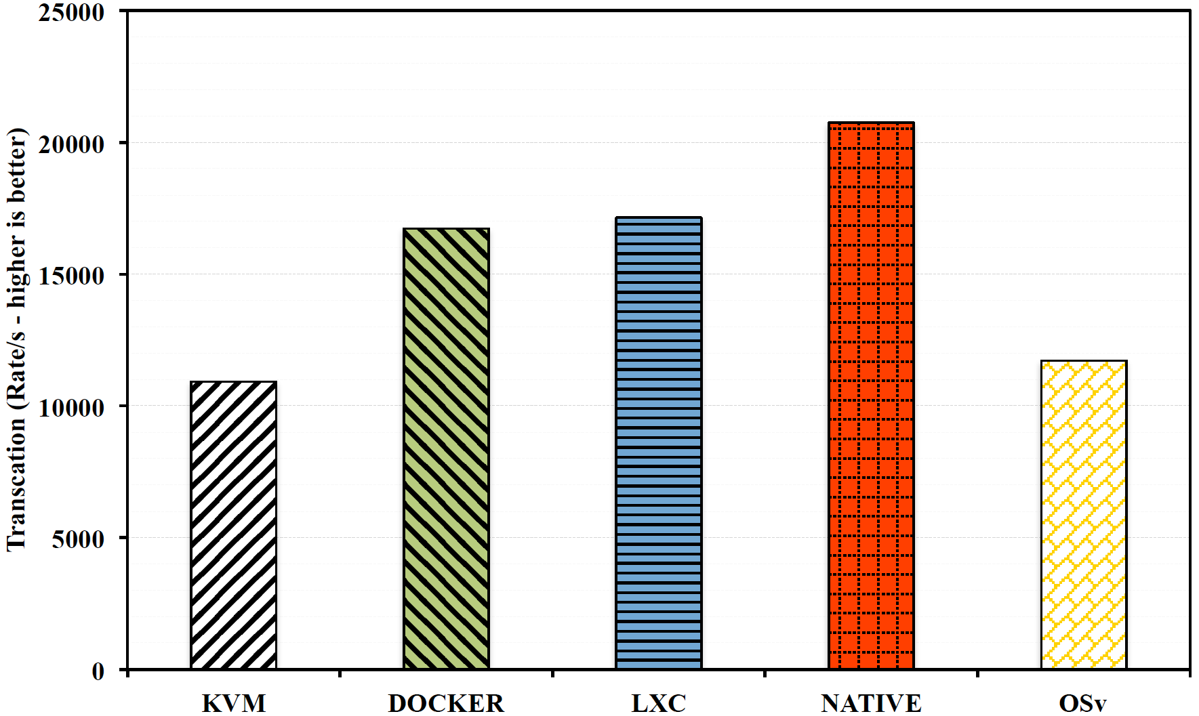
Network Performance
TCP_RR (Request and Response) Test
  Calculate the number of TCP transactions (request and response) exchanged between client and server
≈19%
≈47%
Results for TCP_RR test:
  Docker and LXC introduce a moderate level of overhead (19.36% and 17.35%)
  KVM offers the lowest result (47,35% slower than native)
  OSv performs better than KVM (roughly 4% faster)

Slide 28
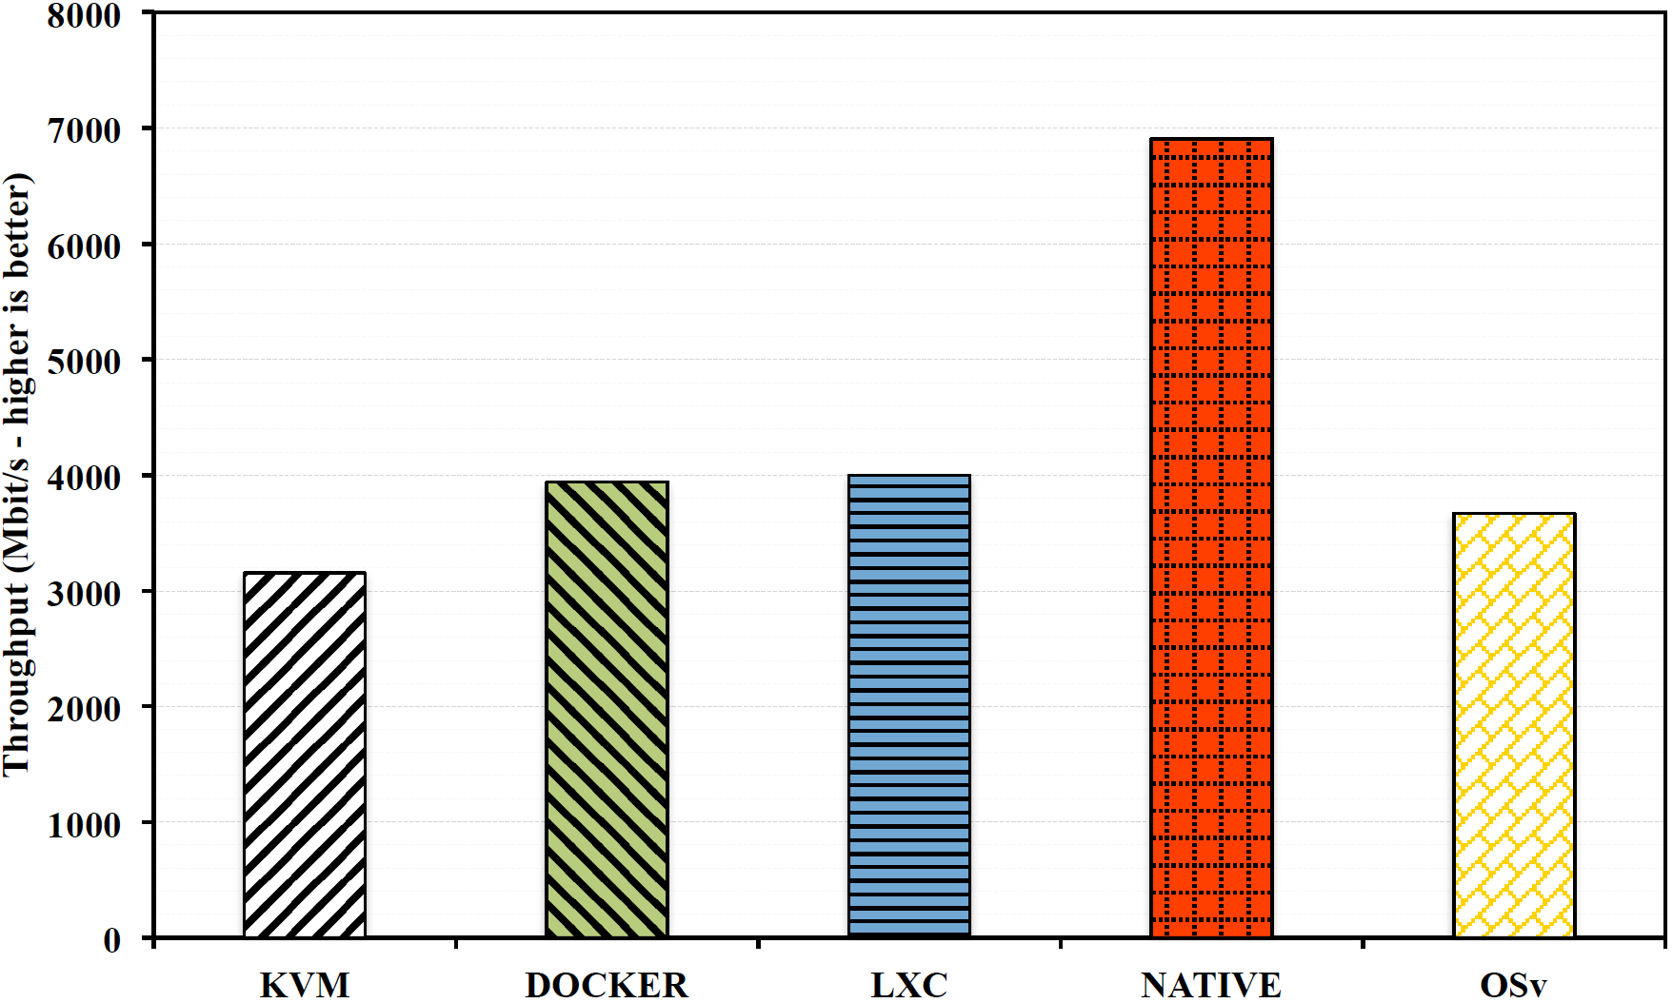
Network Performance
UDP_STREAM Test
  UDP is used as transport protocol
  Simple UDP data transmission between client and server
≈43%
≈42%
Results for UDP_STREAM test:
  All platforms offer lower throughput with UDP
  KVM overhead is the largest (54.35%)
  OSv is faster than KVM, but the gap compared to Native is still large (46,88%)

Slide 29
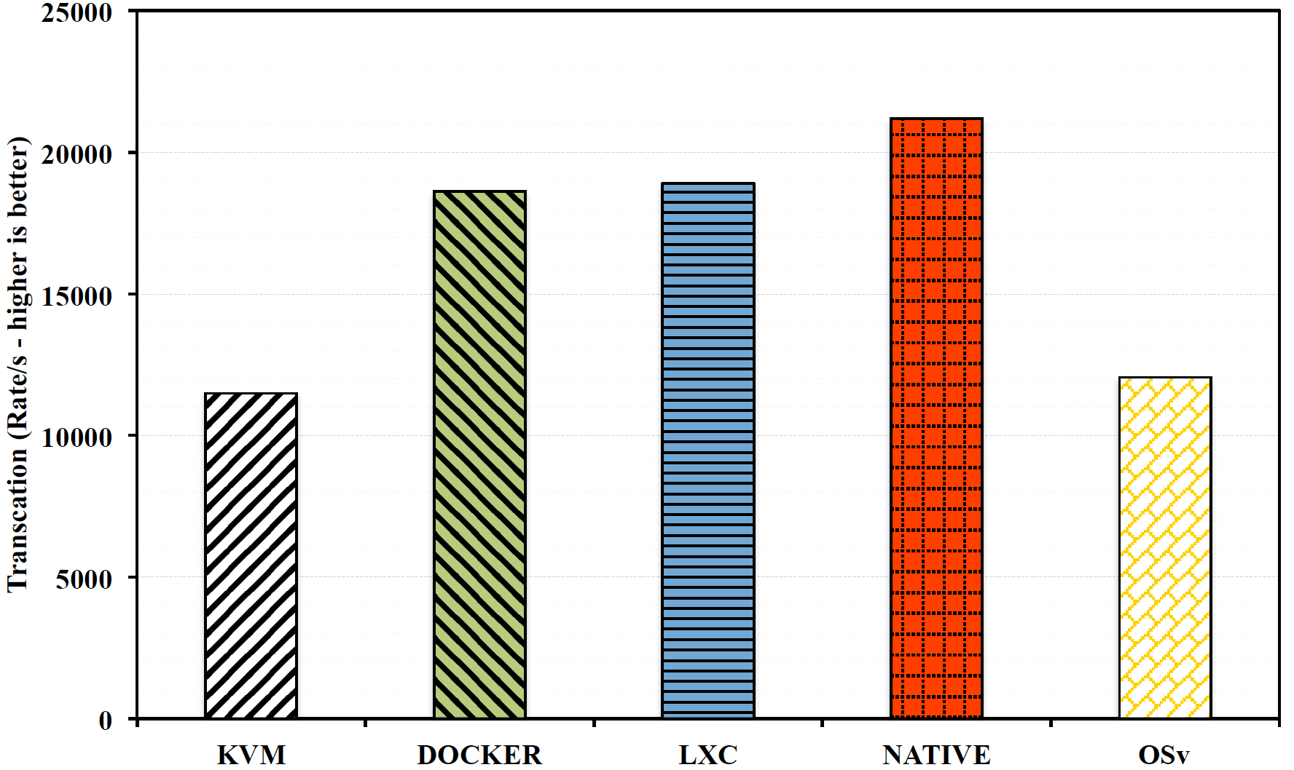
Network Performance
UDP_RR Test
  Calculate the number of UDP transactions (request and response) exchanged between client and server
≈11%
≈43%
Results for UDP_RR test:
  Similar results with the TCP_RR test
  Compared with Native: Docker 12,13% slower, LXC 10,82% slower
              OSv 43,14% slower, KVM 45,76% slower

Slide 30
Conclusions
Container-based solutions and others emerging systems are challenging traditional hypervisor based virtual machines in cloud computing
Lightweight technologies facilitate a more dense deployment of instances
Hypervisors performance have dramatically improved during the last few years
  Disk I/O efficiency can represent still a bottleneck for some types of applications

Slide 31
Conclusions
Level of overhead introduced by containers can be considered almost negligible
  Versatility and ease of management is paid in terms of security
Network efficiency represent an important open issue for all solutions (especially UDP traffic)
OSv represents an interesting work-in-progress alternative although it introduces some limitations in terms of software portability

Slide 32
Future Work
Next Steps:
  Energy Efficiency and Power Consumption analysis
  Container monitoring and Resource Management
  Further investigations into OSv, ZeroVM, Rocket, LXD, Snappy Ubuntu, Project Atomic, CoreOS etc.
  Microbenchmarking
  Paravirtualization (e.g. Xen)
  Performance evaluation using specific workloads
  …

